Slide 1

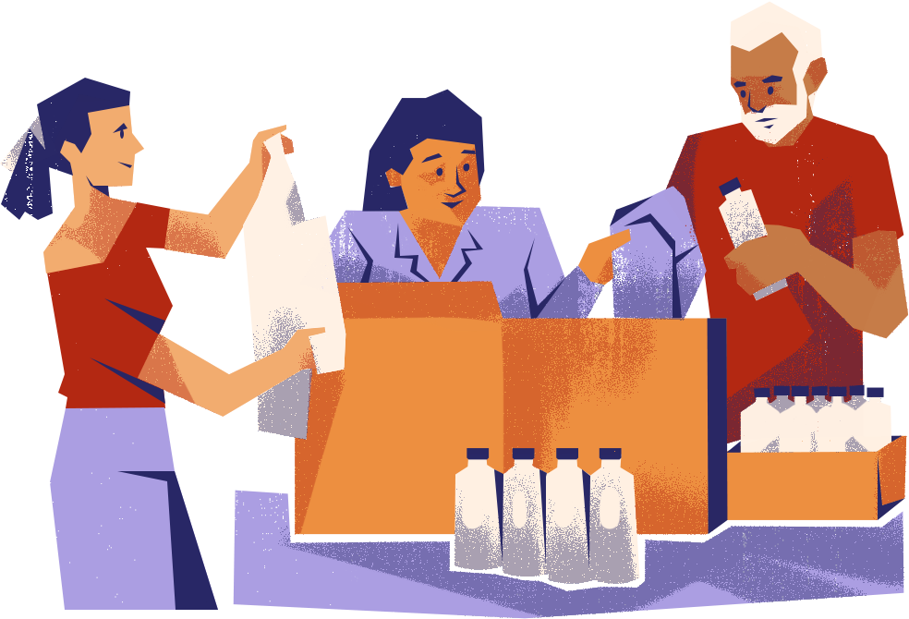
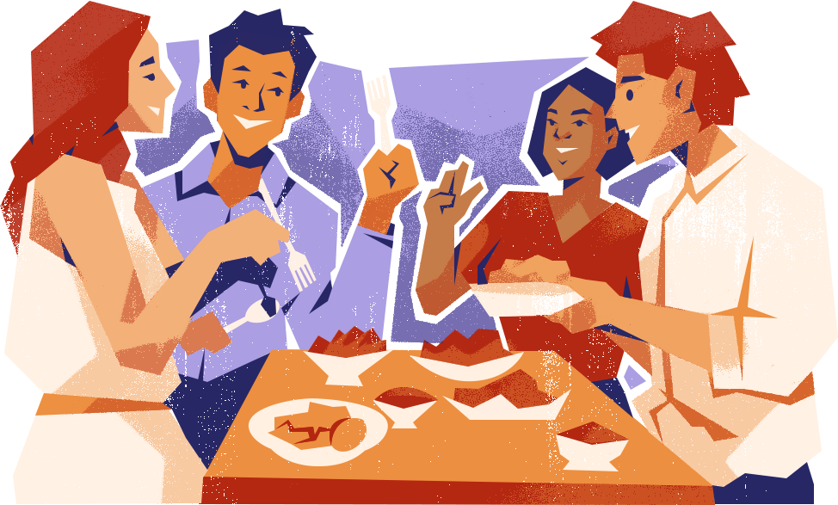
CS 147
ShopCrawl
Shop with friends. Make it fun.

Slide 2



The ShopCrawl Team
Anthony
Luke
Isaac

Slide 3



The Problem
1.Chore shopping is boring and monotonous
2.It’s hard for people to meet new people
3.Time is valuable

Slide 4

The solution?

Slide 5

Shop Crawl:
Make Shopping a party

Slide 6
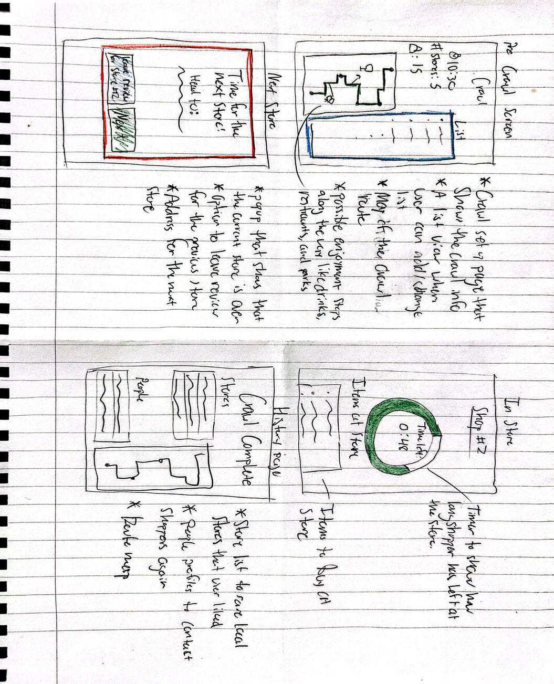
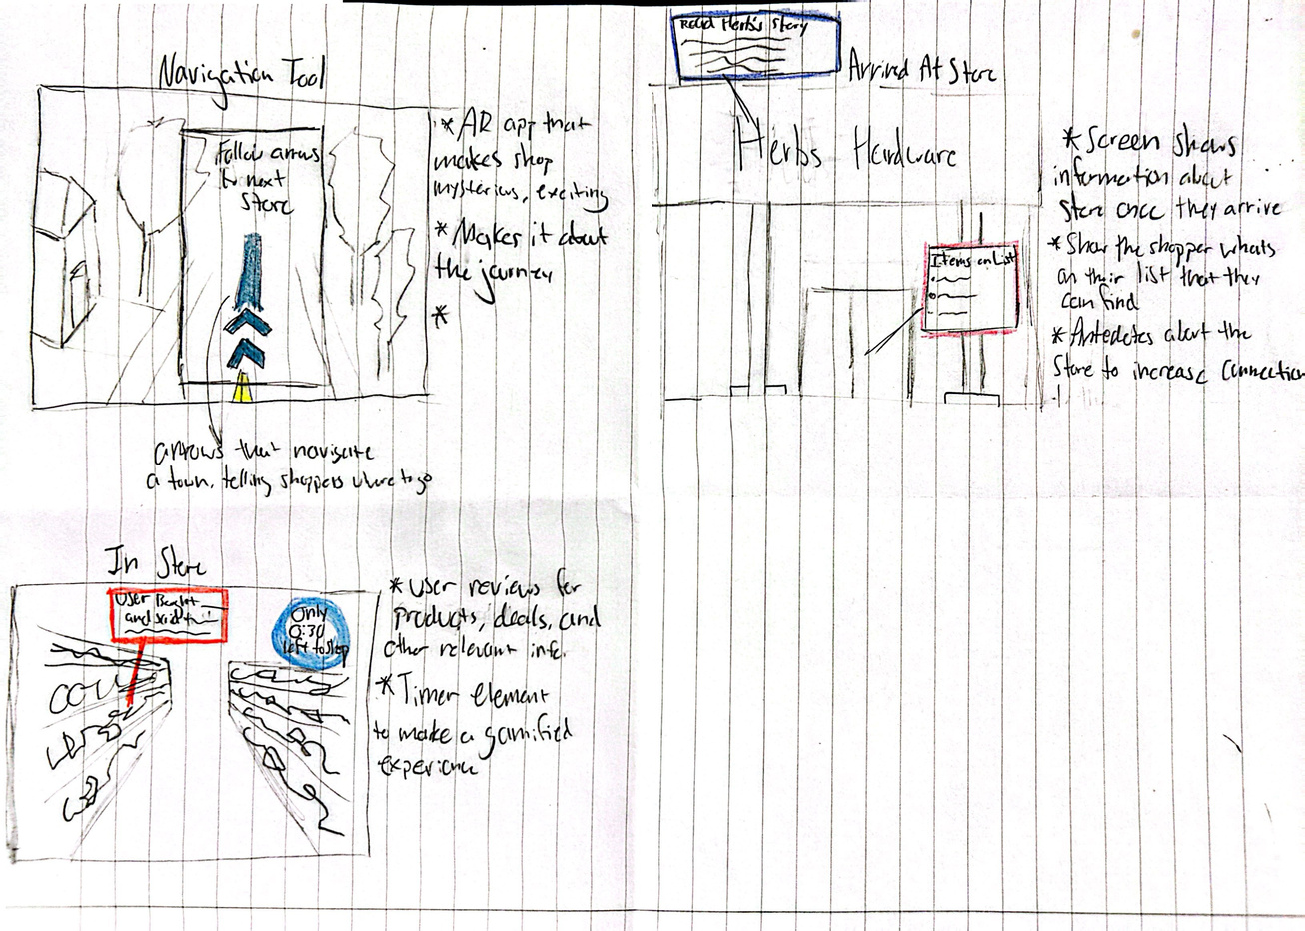
Sketching Explorations
Concept Sketches
AR
Tablet

Slide 7
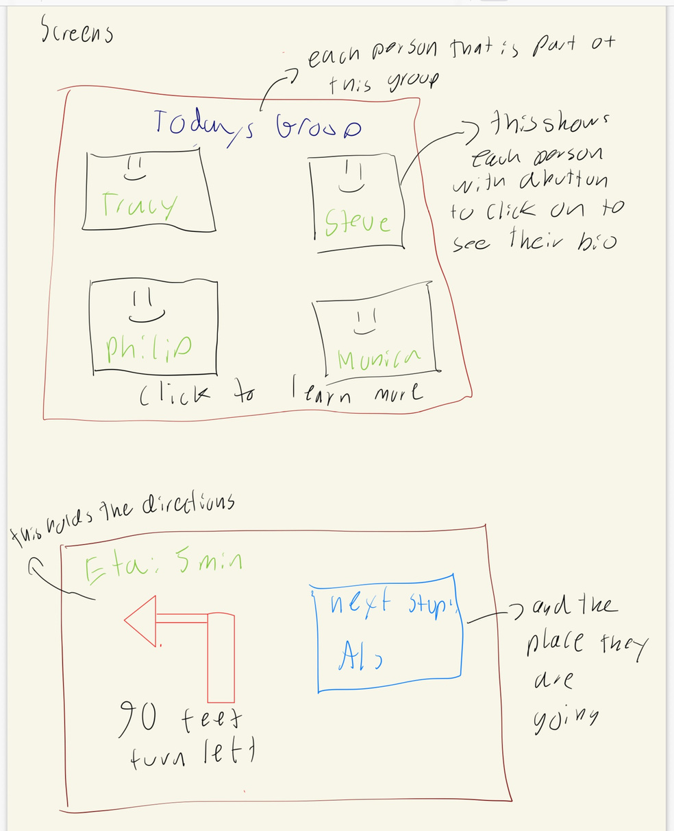
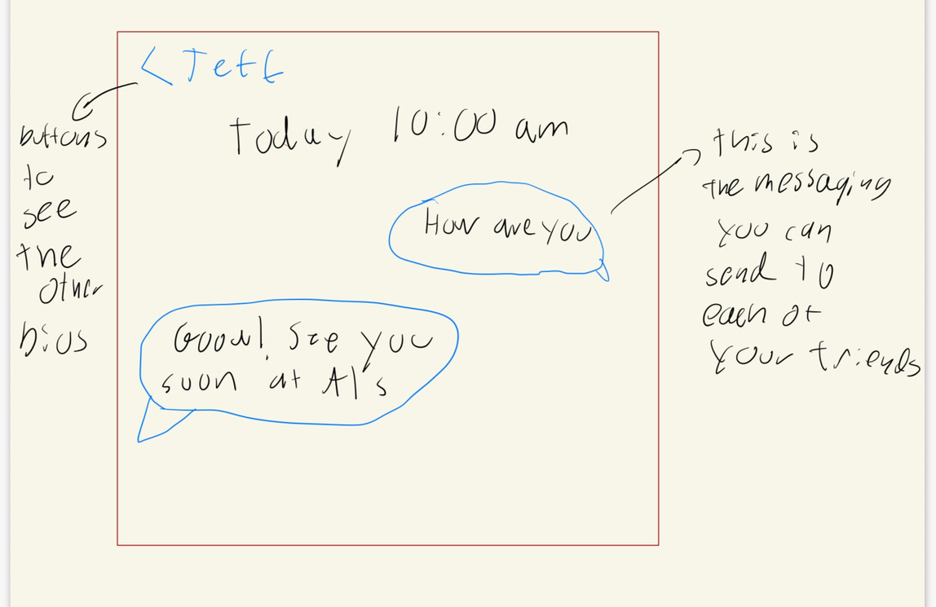
Realizations - Wearable

Slide 8
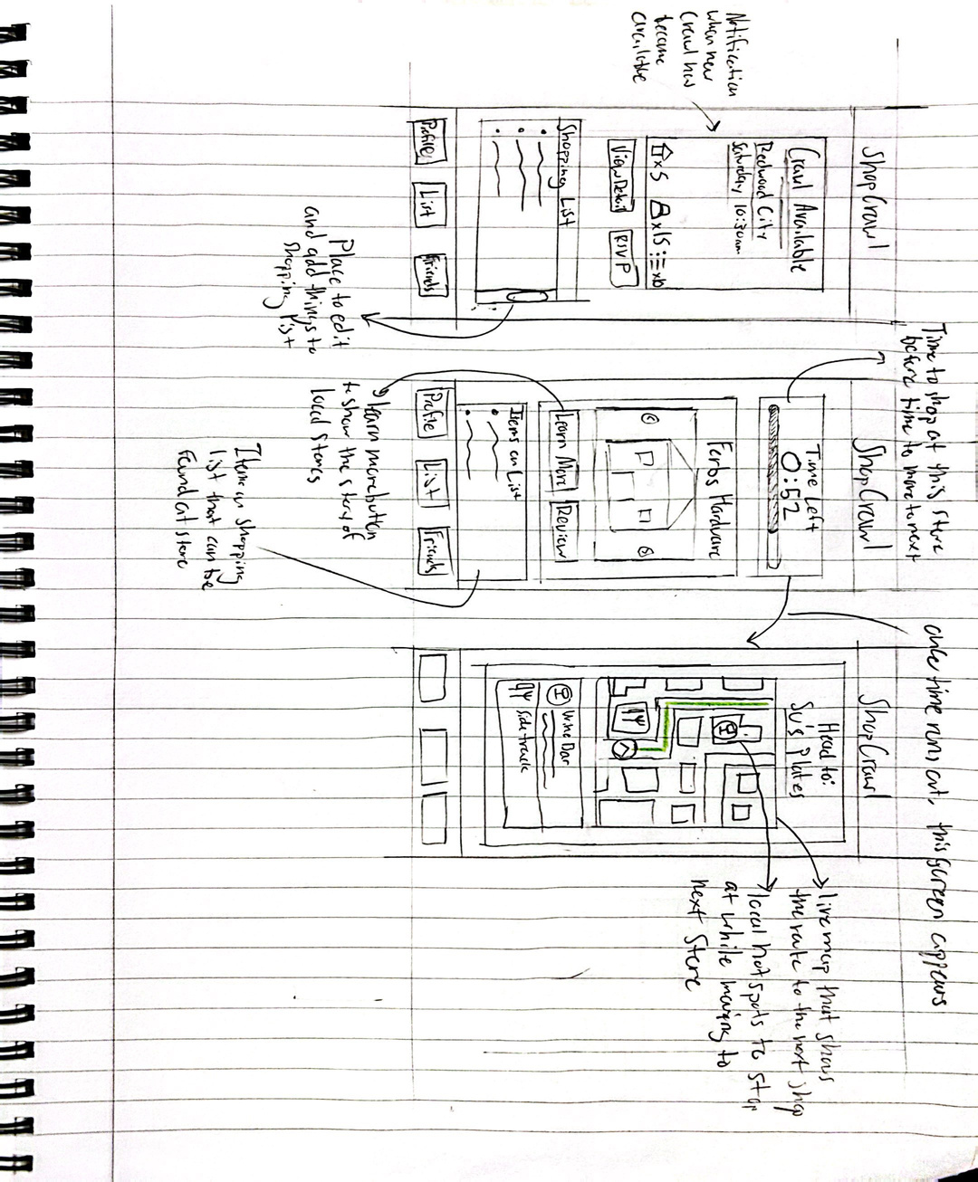
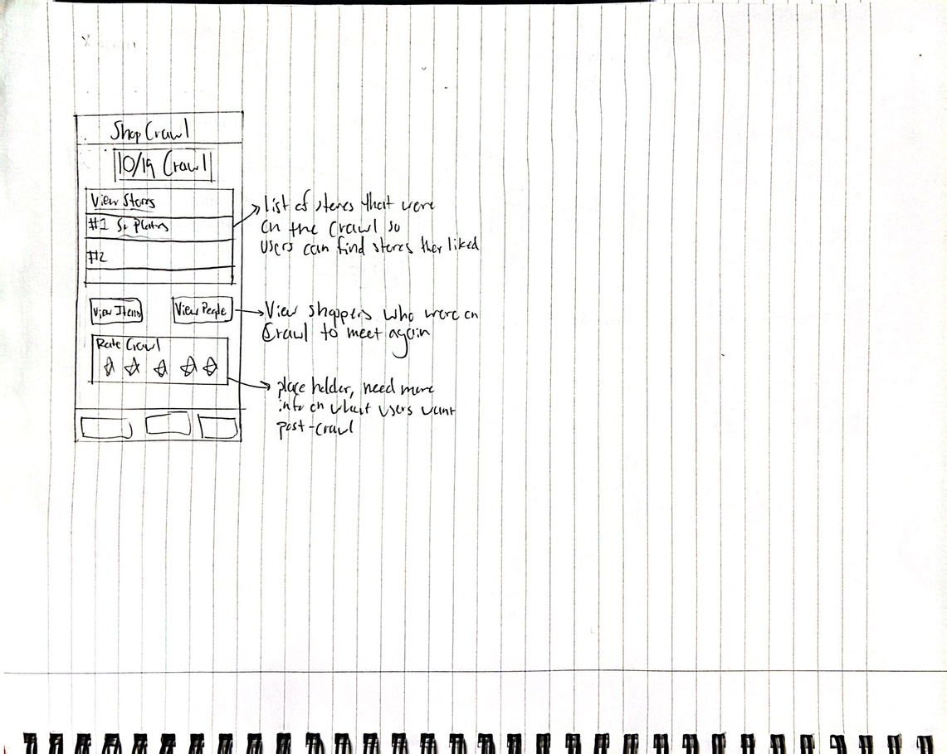
Realizations - Tablet

Slide 9
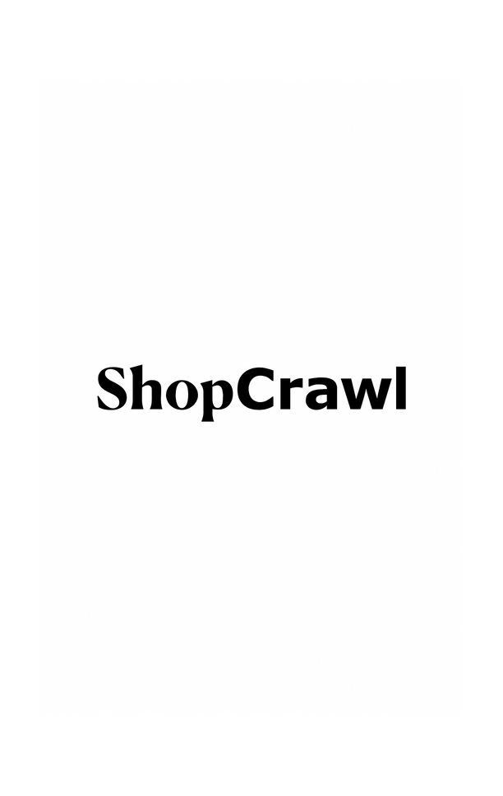
Interface
Pros
Cons
Suitable and comfortable for users to conduct social interactions
Harder to stand out for social features
Larger screen allows us to convey more information about crawls
“just another” shopping app
Shopping and phone apps have become synonymous
Lack of physical integration into the shopping experience
Integrated easily into the digital side of shopping
Veteran shoppers will be less willing to adopt a new shopping style

Slide 10
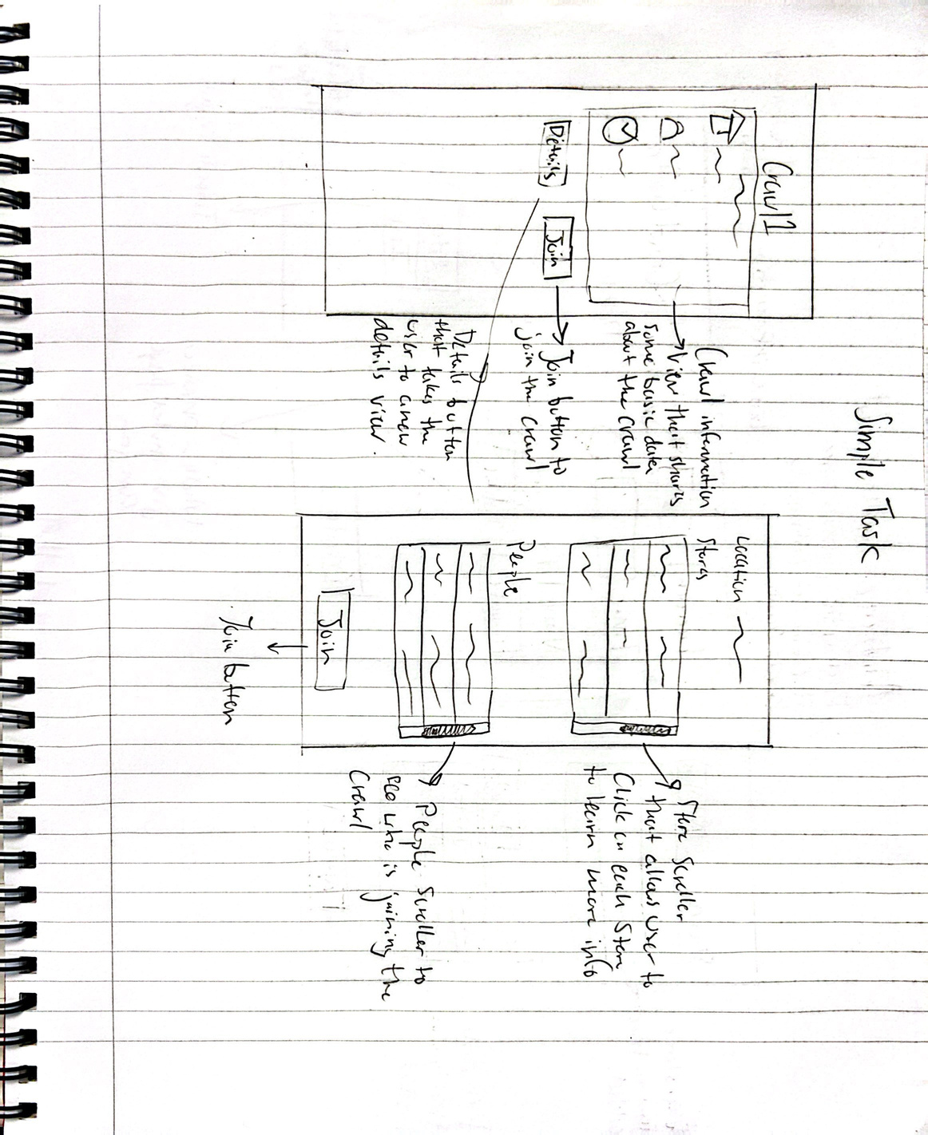
Task Flows
Simple:

Slide 11
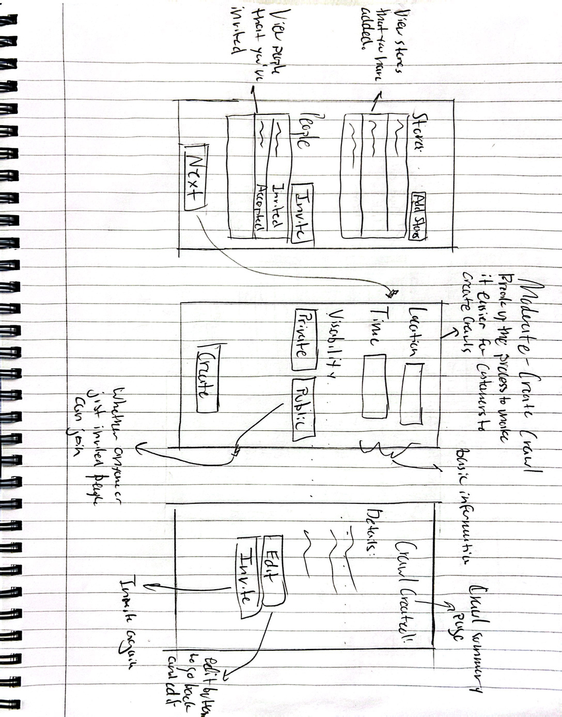
Task Flows
Moderate:

Slide 12
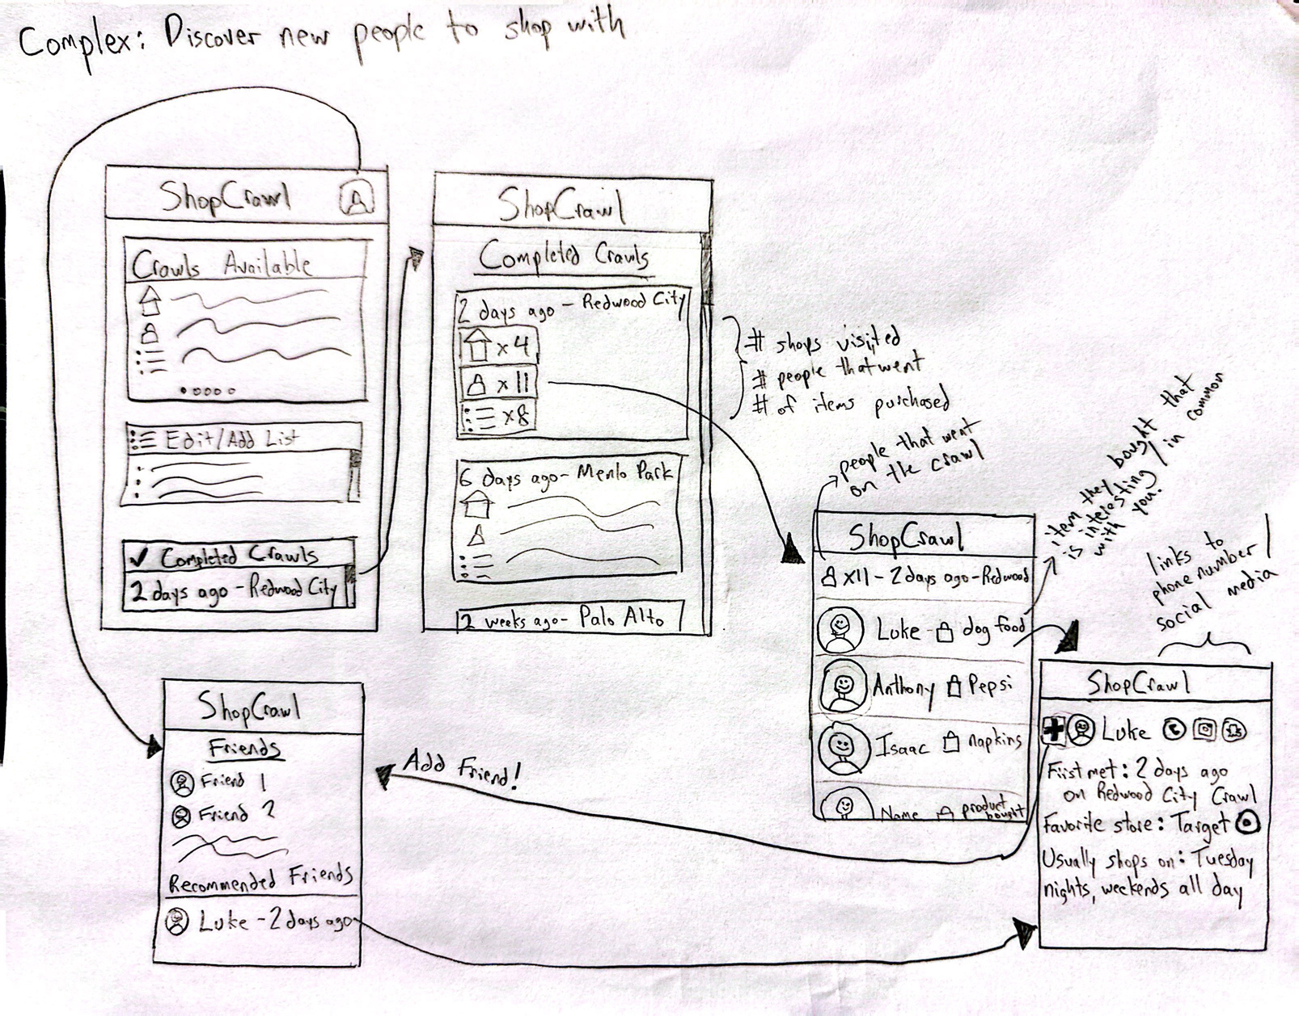
Task Flows
Complex:

Slide 13
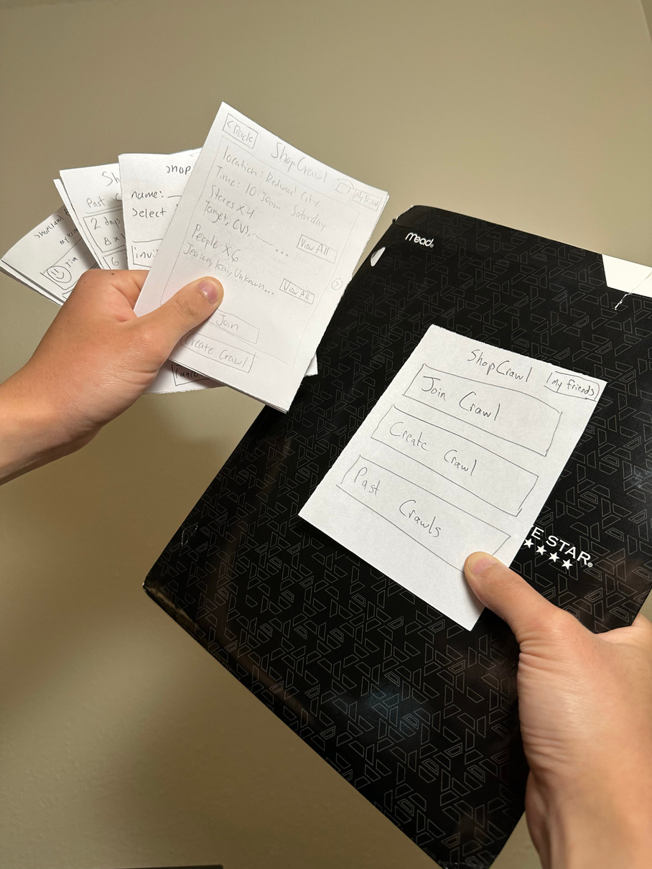
Low-Fi Prototype Construction
Built on quarter-size paper to simulate phone app size.
Organized sheets into the three tasks to streamline team member’s execution of each task.
Protype starts from the homescreen, and operates on a flat surface.

Slide 14
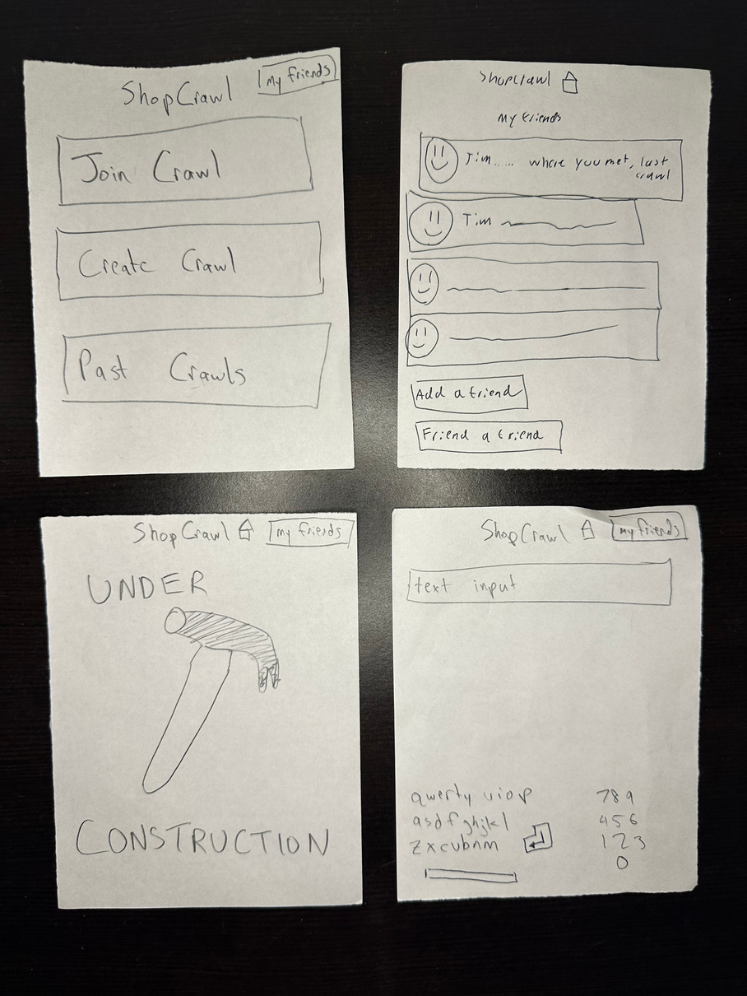
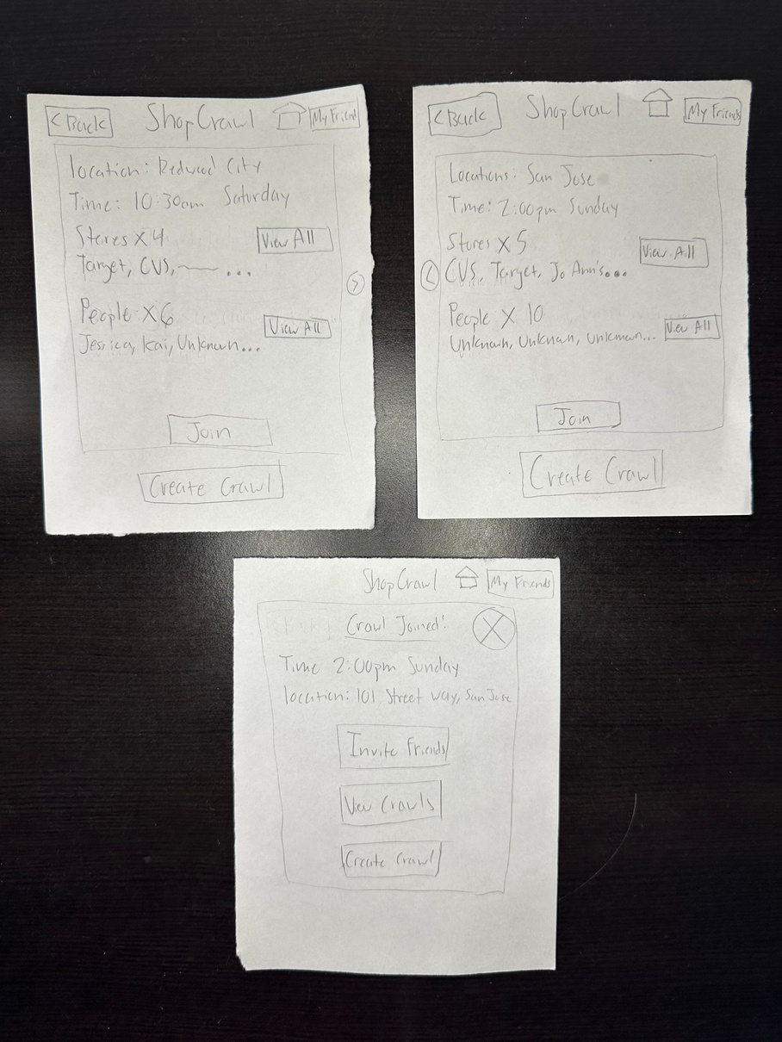
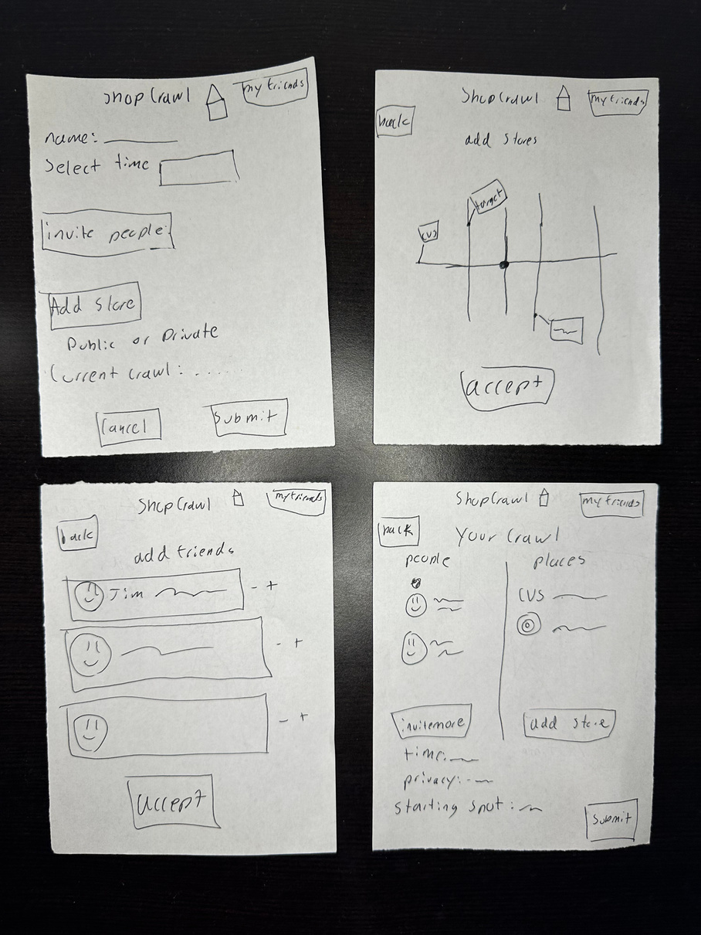
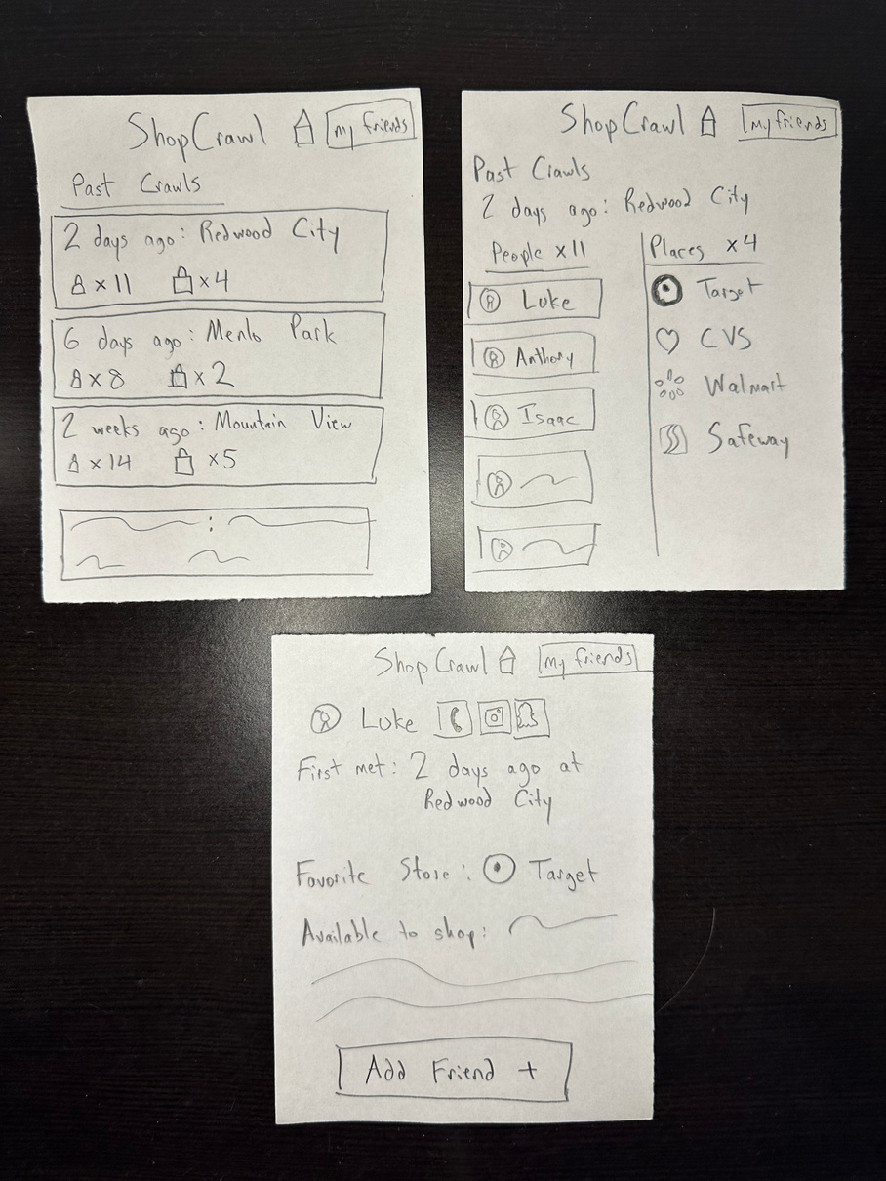
Low-Fi Prototype
Home and
Miscellaneous Screens
Join Crawl
Simple Task
Create Crawl
Moderate Task
Past Crawls
(Connect with People)
Complex Task

Slide 15
Testing Methodology
Participants, Environment, and Procedure
Who?
Where?
How?
Chuck, Nate, and Blair
Nate at Tressider and Chuck and Blair at Sur La Table
For Tressider: Anthony did the prototype while Luke took notes
Wanted younger audiences, asked outside of popular chore based stores
Tested on tables outside stores
For Sur La Table: Isaac did prototype while Luke took notes
No compensation or outside recruiment necessary
Tested after they had shopped
Showed them a quick demo before letting them play around with it

Slide 16
Testing - Usability Goals
 | Goal 1: Engagement and Eagerness | Goal 2: Efficiency and Ease of Use
Why test now? | Engagement lets us know if the concept sparks interest. | Long completion times show concept failures.
Meaning for solution? | High engagement = community potential. | Ease of use = less friction.
Notes:
goal is to make a chore enjoyable so we want to see if the app is adding to the boredom or is a change of pace

Slide 17
Testing - Key Measurements
 | Goal 1: Engagement and Eagerness | Goal 2: Efficiency and Ease of Use
Process Data | Observations of enthusiasm and engagement | Time spent on the last task from “Past Crawls”
Bottom-line Data | “1-5, how interested are you in using ShopCrawl again?” Aim for > 4 average. | “1-5, how easy was it to complete the last task?” Aim for > 4 average.

Slide 18
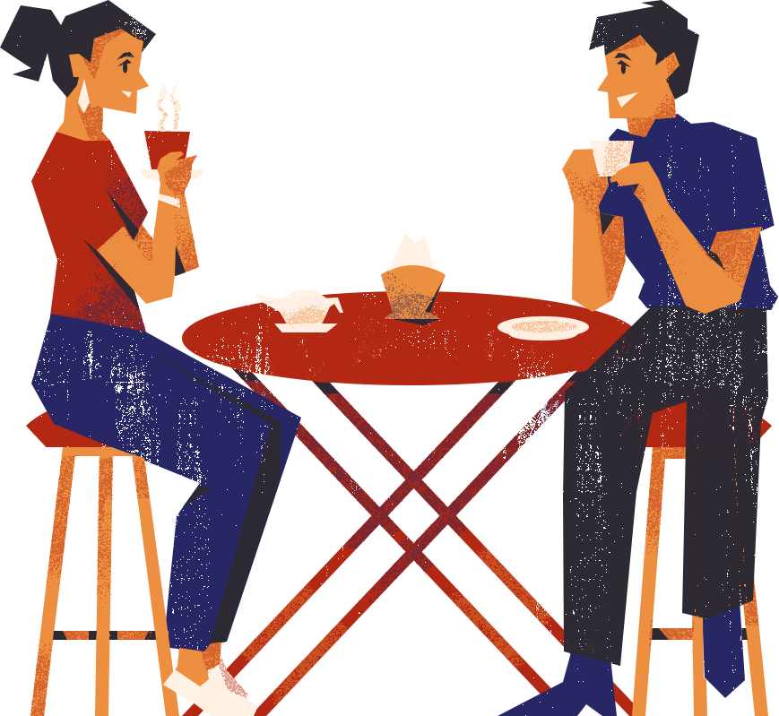
Test Results - Engagement
Comments made by participants
“[Seems like] a really interesting way to make friends when we’re busy in life.”
Chuck
“I usually hate shopping so I always get it delievered. I like it cause it might make it actually fun”
Blair
“This is fire.”
Nate
Notes:
For our process data, these quotes were especially interesting to us
Chuck stated [quote] while completing the complex task and after looking at the "friends" page
Blair stated this when joining a crawl and she saw the list of stores and people on the crawl
Nate kept repeating the same, eloquent quote throughout the testing: quote

Slide 19
Test Results - Engagement
On scale of 1-5, how intersted are you in using ShopCrawl again?
4
Chuck
4
Blair
5
Nate
Notes:
When asked how interest were you in using ShopCrawl again on a Scale of 1-5.
Chuck said 4 and gave an explaination that he liked the idea but it seemed like an added step to already "step heavy" process like shopping
Blair said 4 as well and said that she "Would need to see more of a proof of concept" before she would use it regularily
Nate gave ShopCrawl a 5 and said "it was fire"

Slide 20
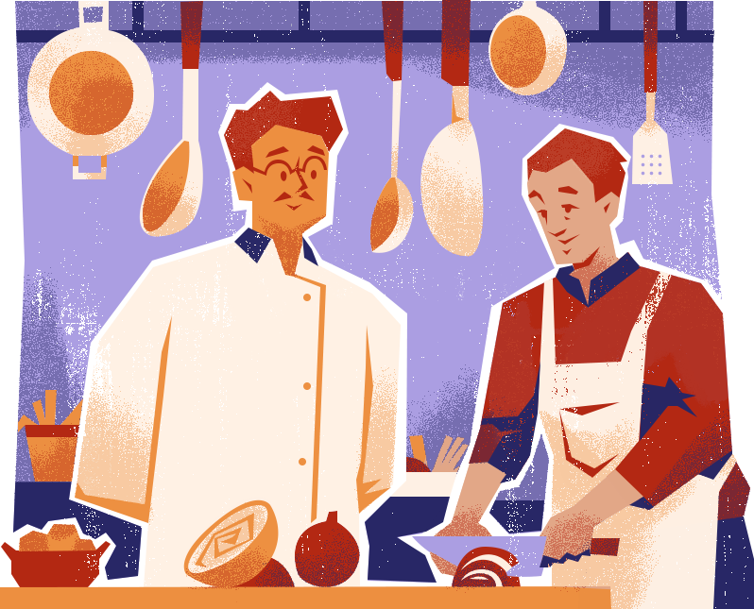
Test Results - Efficiency
Time to complete complex task starting from “Home Page”
21 Seconds
Chuck
Did not complete
Blair
13 seconds
Nate

Slide 21
Test Results - Efficiency
Scale of 1-5, how easy was it complete the last task
4
Chuck
2
Blair
5
Nate
Notes:
For our process data, these quotes were especially interesting to us
Chuck stated [quote] while completing the complex task and after looking at the "friends" page
Blair stated this when joining a crawl and she saw the list of stores and people on the crawl
Nate kept repeating the same eloquent quote throughout the testing: quote

Slide 22
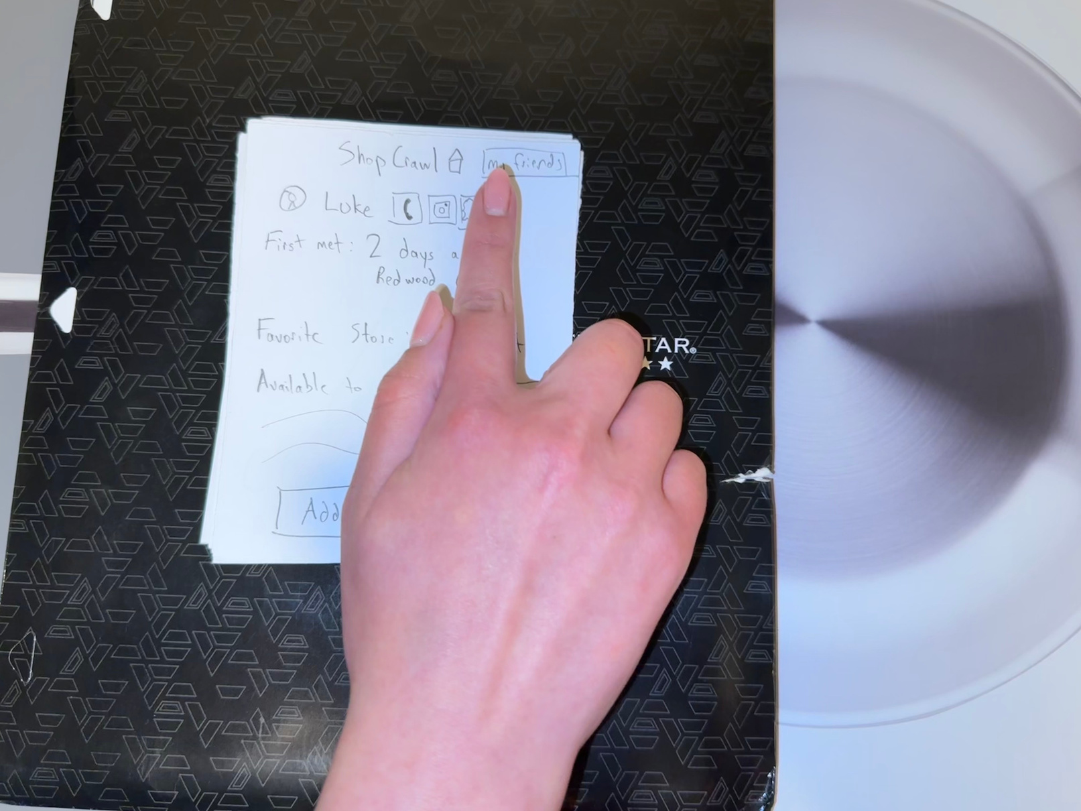
Test Results - Efficiency
Scale of 1-5, how easy was it complete the last task
“I don’t want to add a friend if I don’t know anything about them.”
Blair
Notes:
Blair didn't want to add a friend because she felt like it was unsafe. She didn't have enough information about the person, and, maybe the most interesting insight, there was no report button, so she felt like there was no punishment or combing of "bad actors".
I think this revealed to us that if we want to have a social feature, we're going to have to consider significant design choices regarding safety within our app.

Slide 23
Discussion
“I don’t want to add a friend if I don’t know anything about them.”
Catastrophic issue: social safety and trust.
Blair refused to add a friend without knowing more about the person.
Implications
Implement a user reputation system (ratings and reviews) and a report feature.
Changes
Will physically meeting the person during a crawl create more trust?
What Testing didn’t Reveal
Notes:
Blair didn't want to add a friend because she felt like it was unsafe. She didn't have enough information about the person, and, maybe the most interesting insight, there was no report button, so she felt like there was no punishment or combing of "bad actors".
I think this revealed to us that if we want to have a social feature, we're going to have to consider significant design choices regarding safety within our app.

Slide 24
Discussion
“I don’t think you need this [my friends] button on every screen.”
“There’s no back button here.”
Issue: Inconsistent / unnecessary buttons broke task flow and increased frustration.
Implications
Simplify navigation by only keeping universal Back and Home buttons.
Changes
Will platform specific gestures (such as back swipe on iOS) further confuse users?
What Testing didn’t Reveal
Notes:
Nate also had something to say about our UI elements in regard to the social features of our app.
He expressed clear confusion and fustration with some of the UI choices within our app which reveals that we have to more heavily consider navigation flow within our app.
Since we had significant tension with our social features, both with the UI elements and the feature itself, we have to reevaulate whether we want to include social features at all. Should we build that as a fundamental part of our app or trust users to handle the social side through out of app interactions?

Slide 25
Appendix

Slide 26
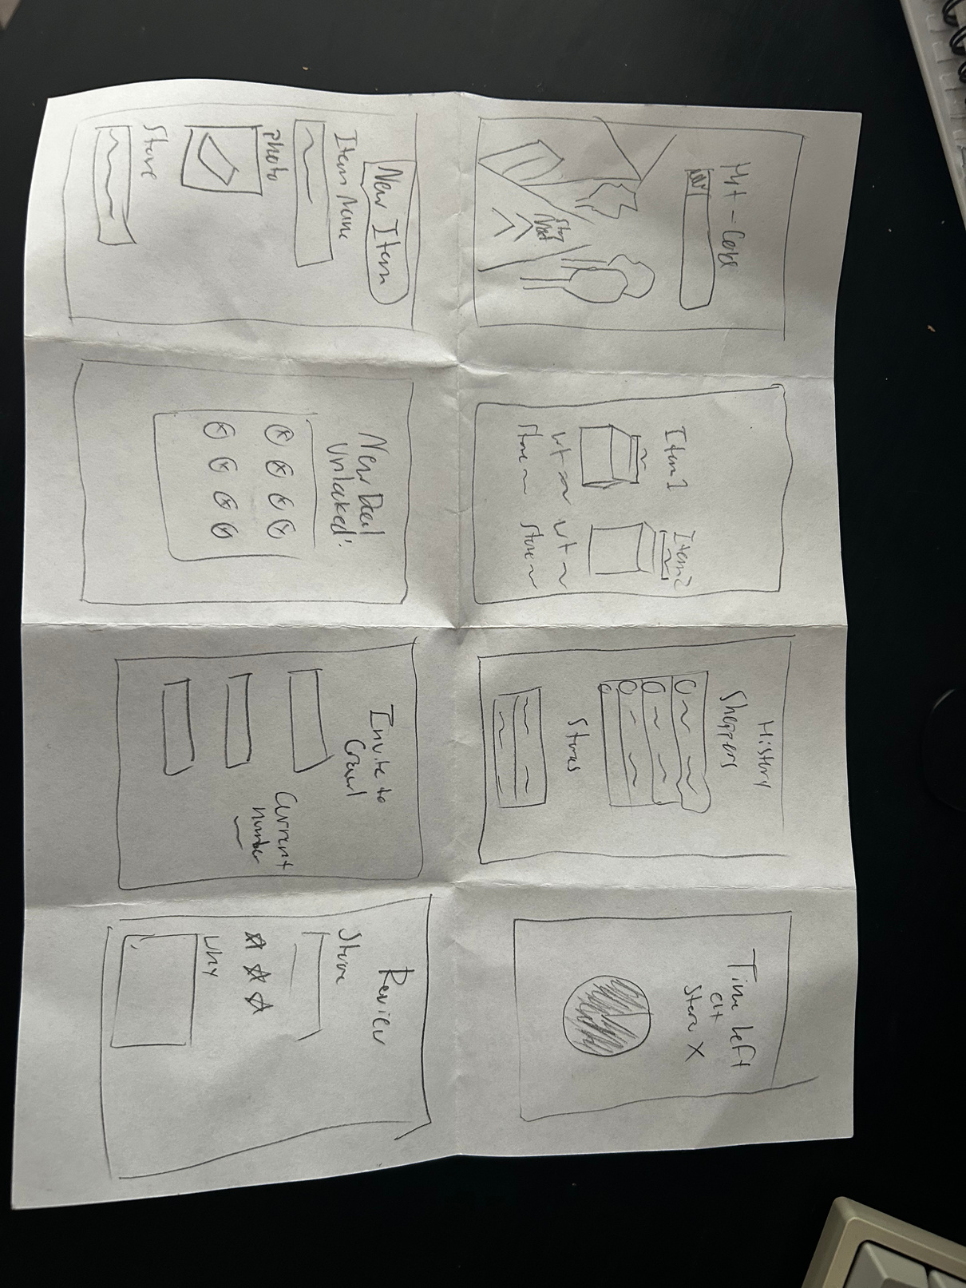
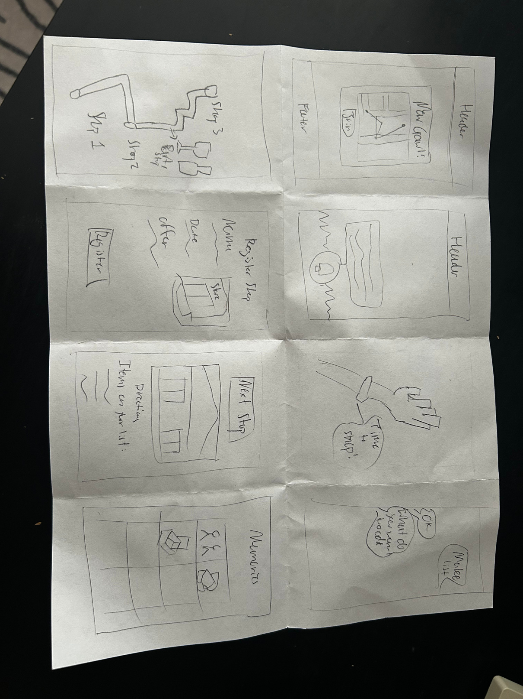
solution Idea Sketches

Slide 27
Pros and Cons of a wearable
Pros
Cons
Users can quickly check crawl routes, store check-ins, or deals without pulling out their phone. This enables smoother transitions between walking, browsing, and purchasing, all beneficial for in person shopping
The small screen makes it nearly impossible to browse crawl options, view detailed maps, or compare store info
A wearable can serve as a visible identifier which signals participation (“I’m on the Crawl!”)
Adding or inviting friends, customizing crawl routes, and setting preferences require multiple inputs or visual fields, which are cumbersome on a smartwatch UI.
The watch form factor naturally supports lightweight, on-the-go engagement. It pushes users to stay active and visit multiple stores, aligning with the experiential, event-based nature of the crawl.
Relying on wearables can exclude potential participants who only have phones, reducing accessibility and making the crawl feel less inclusive to the broader audience.
Because interactions are limited to quick glances or taps, users stay engaged in the in-person experience rather than being absorbed in screens supporting more in person connections
Most core functions (setup, editing, joining, maps) would still need to happen on a phone. The wearable ends up as a “secondary interface,” not a standalone product — limiting its independent usefulness.

Slide 28
Pros and Cons of a wearable part 2
Because of the downsides of a wearable (namely the small screen enabling difficulty to perform our tasks, and exclusivity it has by not being widely available), we decided against it

Slide 29
Justification of our Goals and Measurements
Goal
Goal
Efficiency and Ease of Use
Engagement and Eagerness
Why logical based on the current progress of the project: In our bare bones prototype, long completion times or confusing navigation show where our concept or wording fails.
Why logical based on the current progress of the project: We are designing for social connection. Engagement helps us gauge whether the basic concept sparks enough interest to be adopted beyond a single use, even at its bare bones.
What these goals mean for particular solution moving forward: Ease of use is key, since users will interact with this during chore runs. Early data helps us identify friction before investing in high-fidelity design.
What these goals mean for particular solution moving forward: We need to ensure the app is not only usable but enjoyable, motivating users to return for future crawls. High engagement signals strong community potential.

Slide 30
Test Preparation
Script
Introduction
Task Testing
Wrap up
“Hi, we’re testing a prototype of our app called ShopCrawl, which helps people join, create, and connect through social chore shopping crawls. I’ll ask you to complete a few tasks in the prototype, one at a time. Please think aloud as you go. [Name] will observe and take notes, while [I] will be the facilitator and computer moving around the paper prototype. Before we begin, I’ll briefly demo the system so you understand how the app works.”
Task 1 – Join a Crawl (Simple)
“You’ve just opened ShopCrawl because you want to join a crawl happening near you. Your task is to find a crawl that looks interesting and join it. Remember to think aloud as you go.”
Task 2 – Create a Crawl (Moderate)
“Now, imagine you want to create your own crawl.”
Task 3 – Connect with Someone from a Past Crawl (Complex)
“Now, imagine you want to reach out to someone you met on a past crawl, and then add them as a friend.
  “On a scale of 1–5, how easy was it to complete the last task?”
  “On a scale of 1–5, how interested are you in using ShopCrawl again?”
Brief Demo
“You’ve just opened ShopCrawl because you want to join a crawl happening near you. Your task is to find a crawl that looks interesting and join it. Remember to think aloud as you go.”

Slide 31
Overview of Each Page / Demo Flow
Start with the home screen:
  Join Crawl, create crawl, past crawls buttons
  My friends page button
Each screen can go back to the join / create / past or the my friends
My friends:
  My friends screen
  Add or find both lead no where
Past Crawl
  Past home: List view of all the past crawls you have been on, showing how long ago it was, location, number of people that went, and number of shops visited
  Click on a crawl -> Full view of that specific crawl. Has list below of the people that went and the stores visited.
  Click on a person -> View of that person’s profile, with their number, social media, bio, and button to add friend.
  Add friend -> Friend added to friend list
Join Crawl:
  Home screen (sliding view of different ones), arrow to others
  Join button ->
  Create -> create crawl
Create Crawl:
  Home screen (information)
  Add people -> people page
  Add store -> store page
  Submit -> Preview / submit

Slide 32
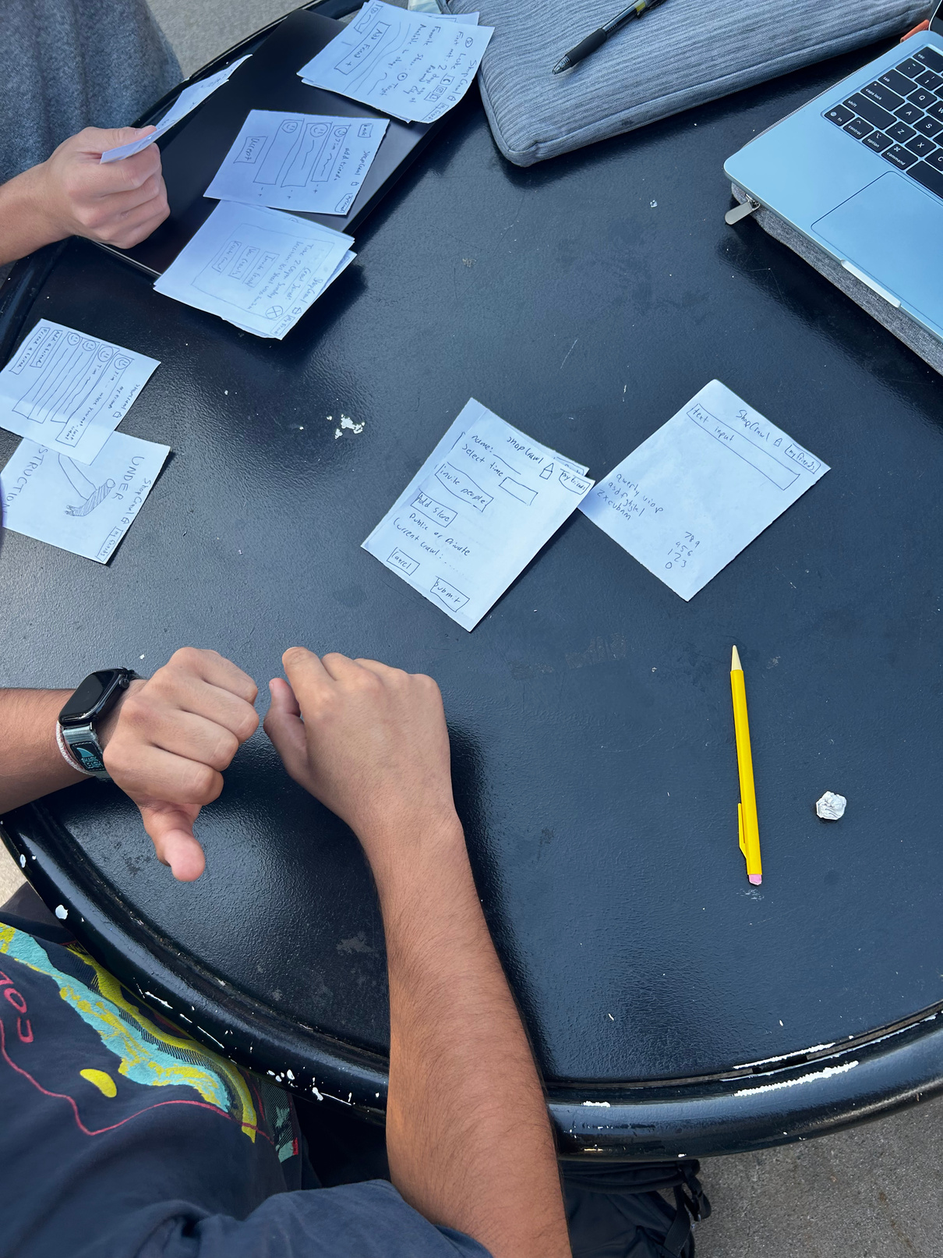
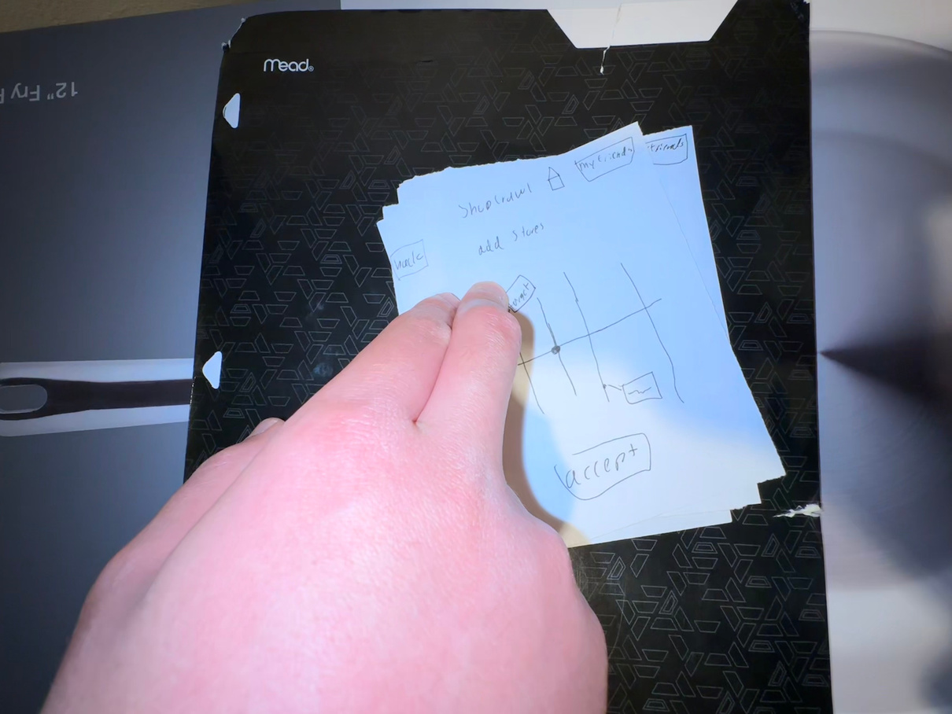
Unused Photos of Testing in Action

Slide 33
Log of Critical errors
Severity, Severity Level, Count, Examples
0 – No problem (Positive): 5 (navigating home, adding store)
1 – Cosmetic: 4 (remove go to my friends)
2 – Minor Usability: 5 (no labeling on view crawl page)
3 – Major Usability: 4 (missing info for editing friends)
4 – Usability Catastrophe: 1 (No safety/rating system)

Slide 34
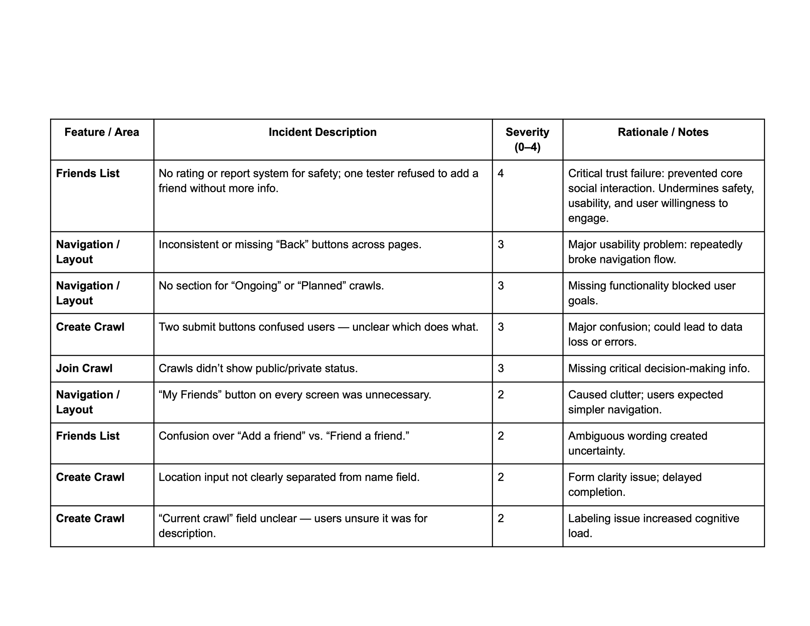
Organized Log of Critical Incidents from Testing 1

Slide 35
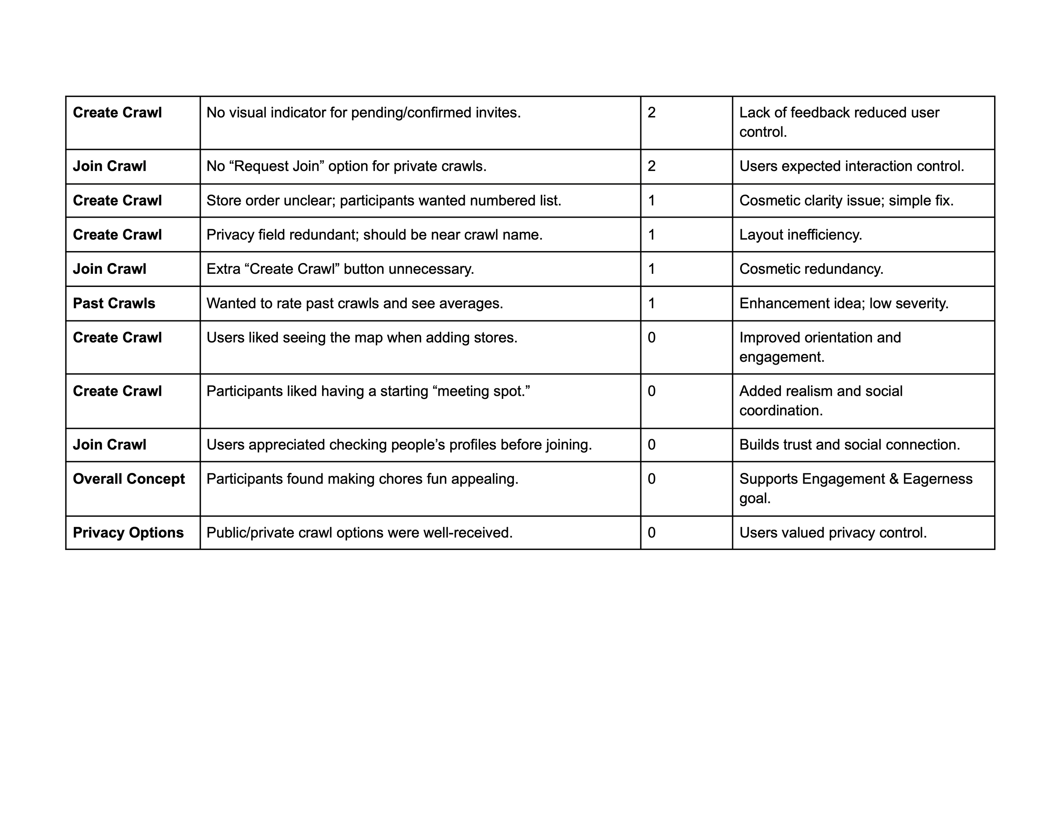
Organized Log of Critical Incidents from Testing 2

